Slide 1
Textile Management System
Presented by:
Prajapati Maunish & Lathiya Dhruvish
BSc IT, Geetanjali College

Slide 2
Introduction & Problem Statement
The textile industry faces significant challenges with traditional manual systems for managing inventory, staff activities, and business operations .
Manual inventory tracking leads to errors, stock discrepancies, and inefficient resource allocation
Staff management and attendance tracking consume valuable time and resources
Inquiry management is handled manually, causing poor follow-ups, missed opportunities, and customer dissatisfaction.
A digitized, integrated solution is needed to streamline operations and maintain competitiveness in the modern textile industry.

Slide 3
Existing Solution (VASTRA App)
VASTRA App offers digitization for textile businesses.
Limitations of VASTRA App:
❌ No web application support.
❌ No role-based access control.
❌ High cost, limiting adoption for small & medium businesses.
To overcome this issue here is our proposed Textile Management System :
✅ Cost-effective, suitable for all business sizes
✅ Role-based access control for secure operations
✅ User-friendly & scalable design
✅ Web application available & access everywhere

Slide 4
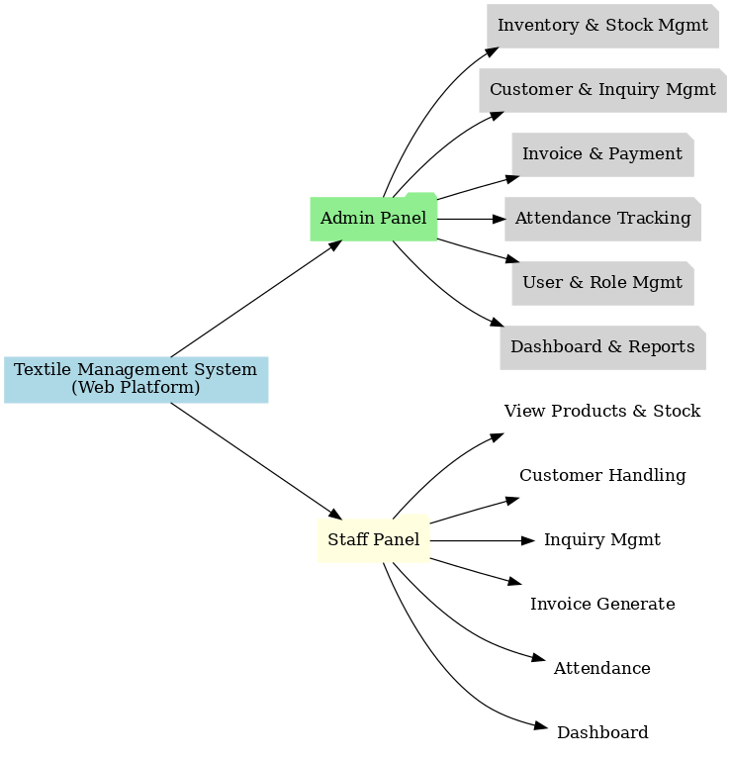
Project overview
✅ Admin Panel: Inventory, staff, customers, invoices, payments, inquiries
✅ Staff Panel: Easy access to manage inquiries, customers, invoices, attendance
✅ Inventory & Stock Management with low-stock alerts
✅ Customer & Inquiry Management with follow-up tracking
✅ Attendance & Staff Management in a centralized system
✅ Payment Tracking with invoice generation

Slide 5




System Overview & Architecture
The Textile Management System is a comprehensive web-based platform that provides centralized control over all textile business operations.
Web Client
PHP
Backend
MySQL
Database
Web-based interface accessible from any device with browser support
PHP backend for business logic processing and dynamic content generation MySQL database for Organized data storage with relational model

Slide 6
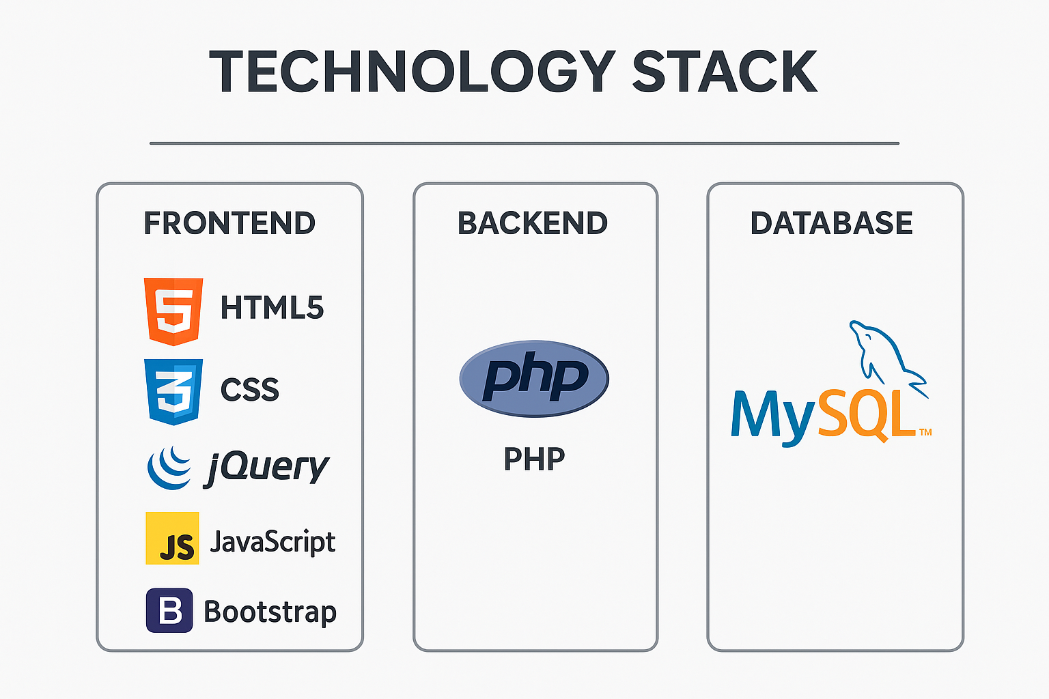
Technology Stack

Slide 7
Team Members & Roles
The Textile Management System was developed as a collaborative college project with each team member’s contribution here are list of modules prepared by individual member including design + backend .
PM
Prajapati Maunish
LD
Lathiya Dhruvish
Product
Category
Stock
Customer
Payment
User
Log
Documentation & presentation
Login System
Dashboard
Invoice
Inquiry
Attendance
Weblink
Stock & payment alerts
Light & Dark mode

Slide 8












Admin Modules Breakdown
The Textile Management System consists of 13 key admin modules that provide comprehensive control over all textile business operations:
User Authentication
Secure login and access control
Dashboard
Sales metrics and KPIs
Products
Add/edit/delete/view products
Categories
Product categorization
Stock
Inventory management
Customer
Customer Information& record
Invoice
Generate and manage bills
Inquiry
Customer query handling
User Management
Staff access control
Payment
Transaction processing
Attendance
Staff presence tracking
Weblink
External link to view products
Log Management
Login tracking & history

Slide 9
Staff Modules Breakdown
The Textile Management System consists of 10 key staff modules that provide comprehensive control over all textile business operations:
User Authentication
Secure login with google authentication
Dashboard
KPIs & performance metrics
Products
view products
Categories
Product categorization view
Stock
View Inventory
Customer
Customer view and add
Invoice
Generate bills
Inquiry
Customer query handling
Weblink
Share products via external link
Attendance
Own presence tracking

Slide 10
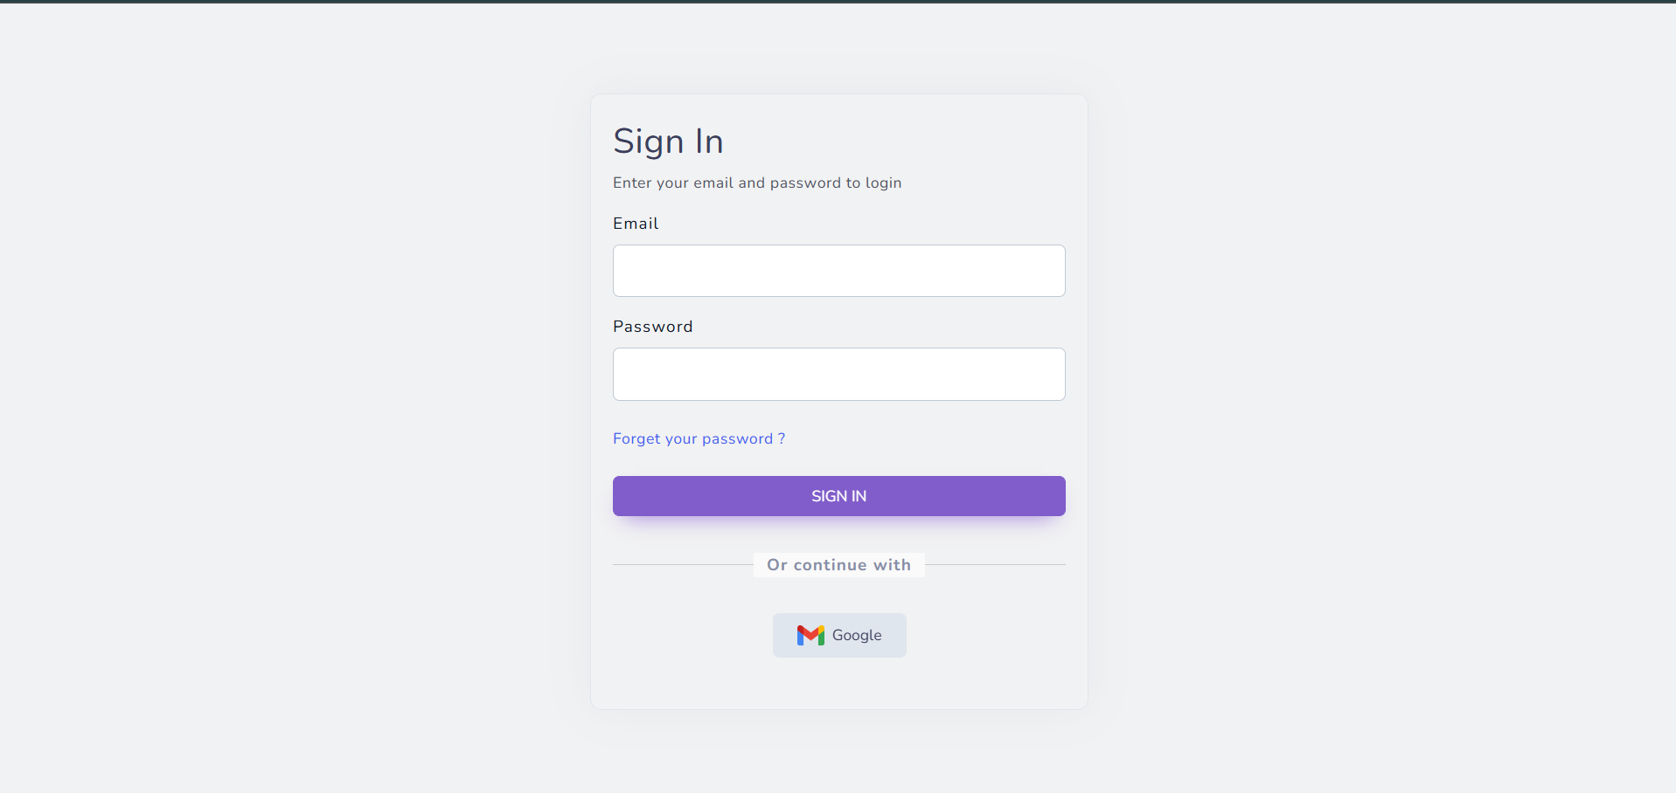

Slide 11
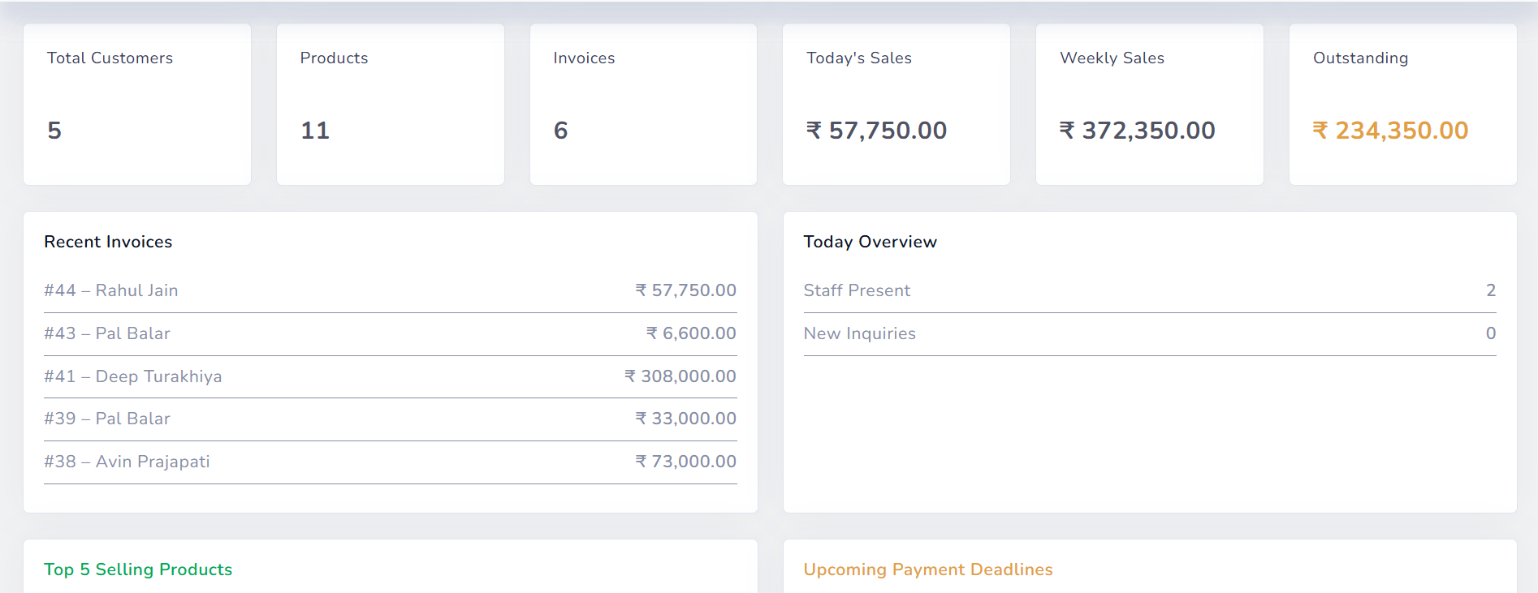
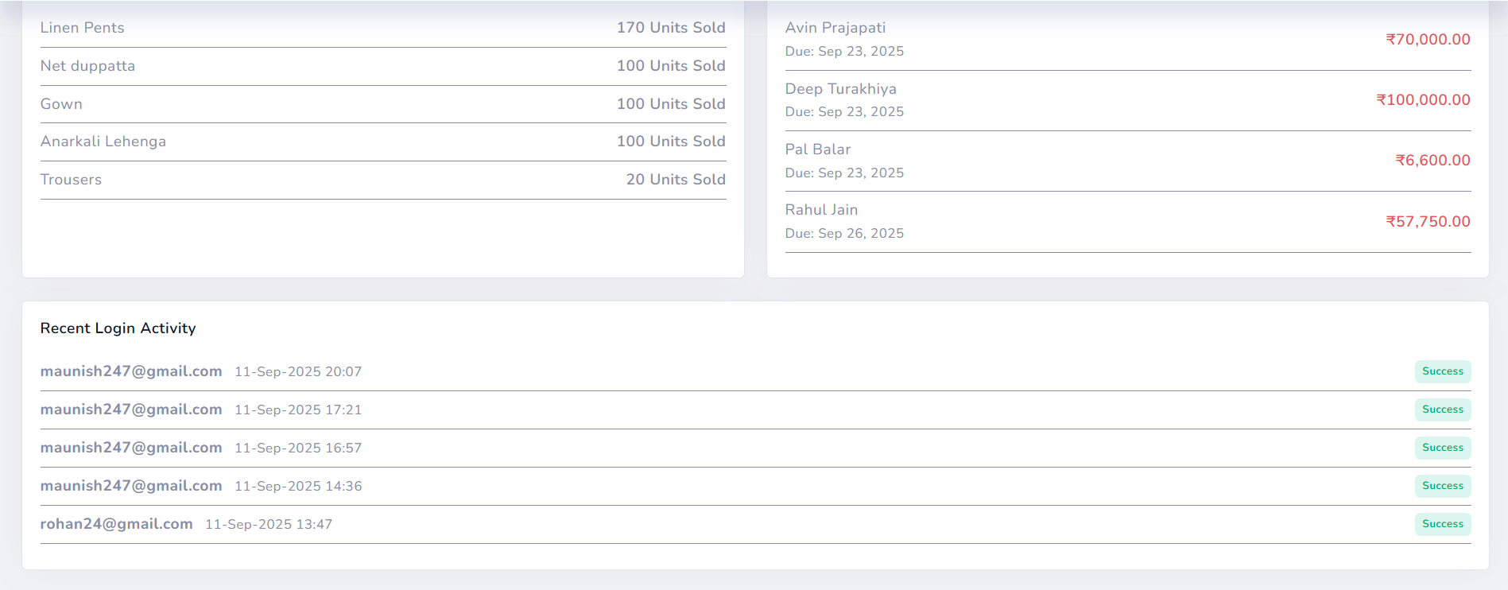

Slide 12
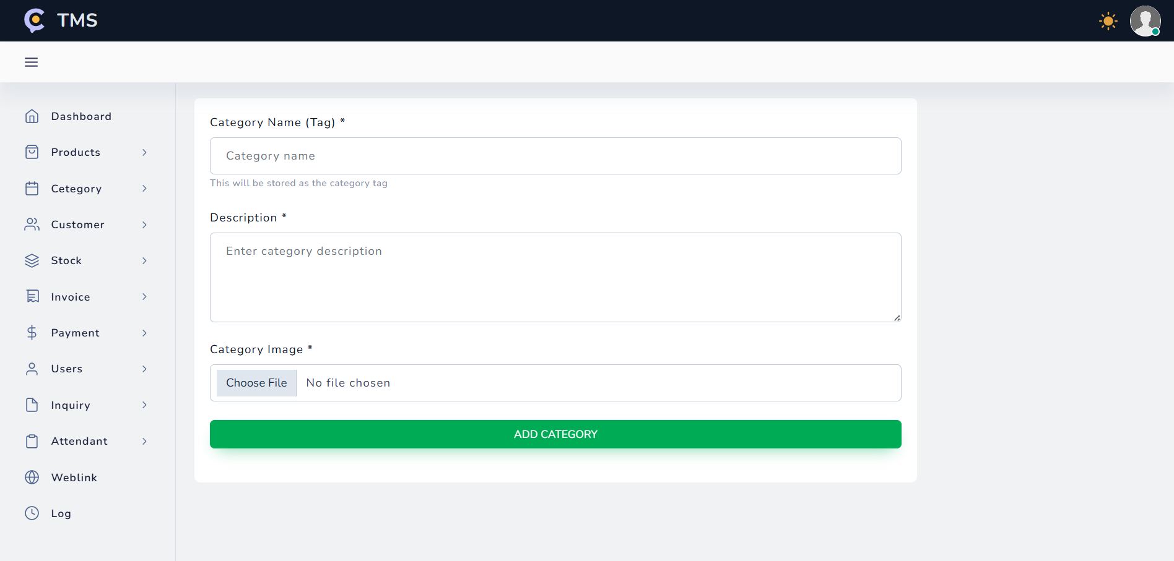

Slide 13
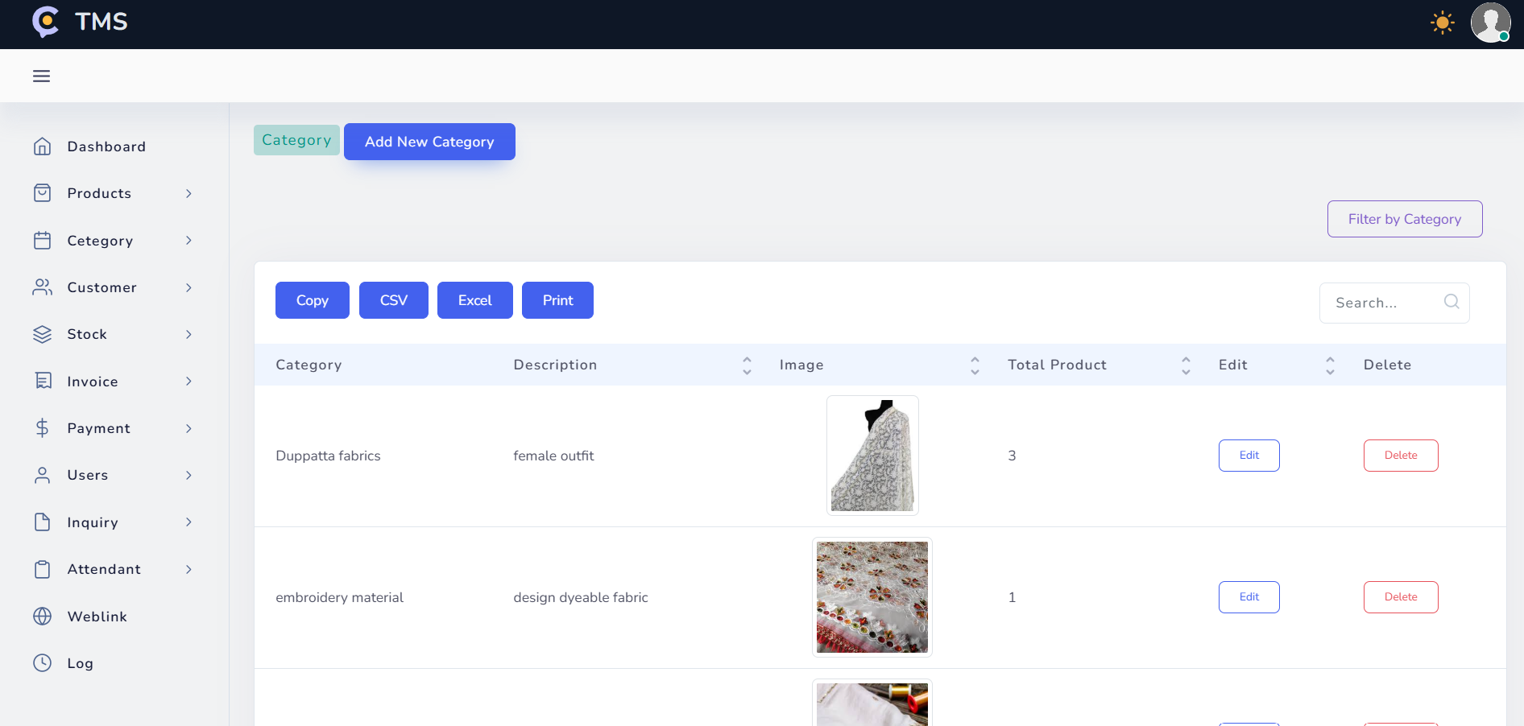

Slide 14
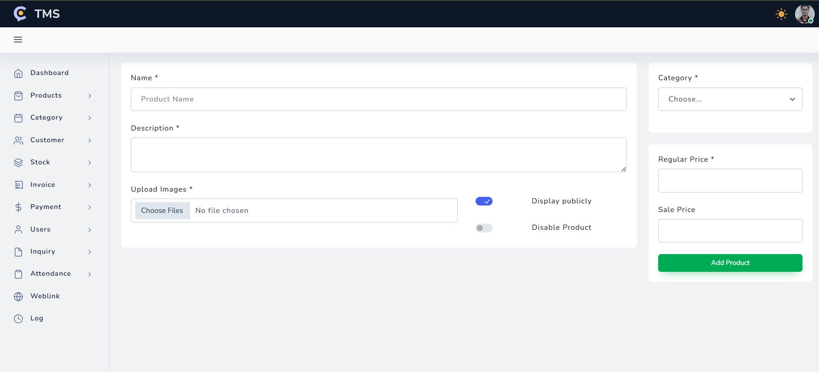

Slide 15
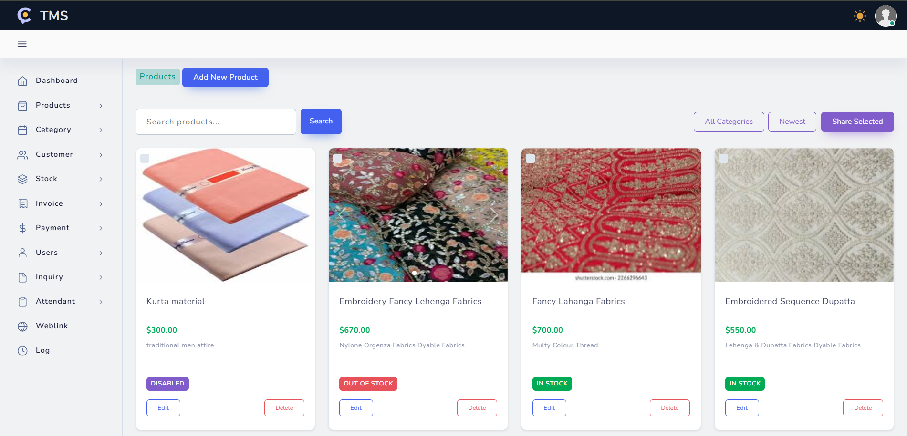

Slide 16
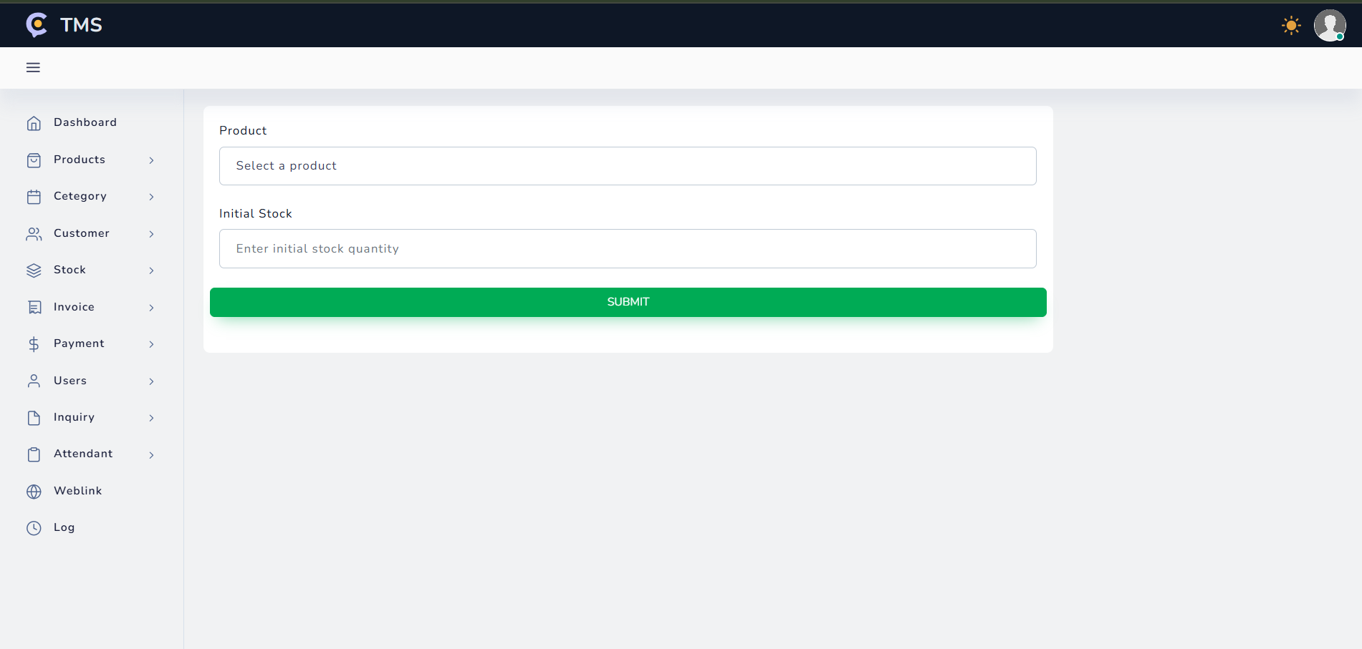

Slide 17
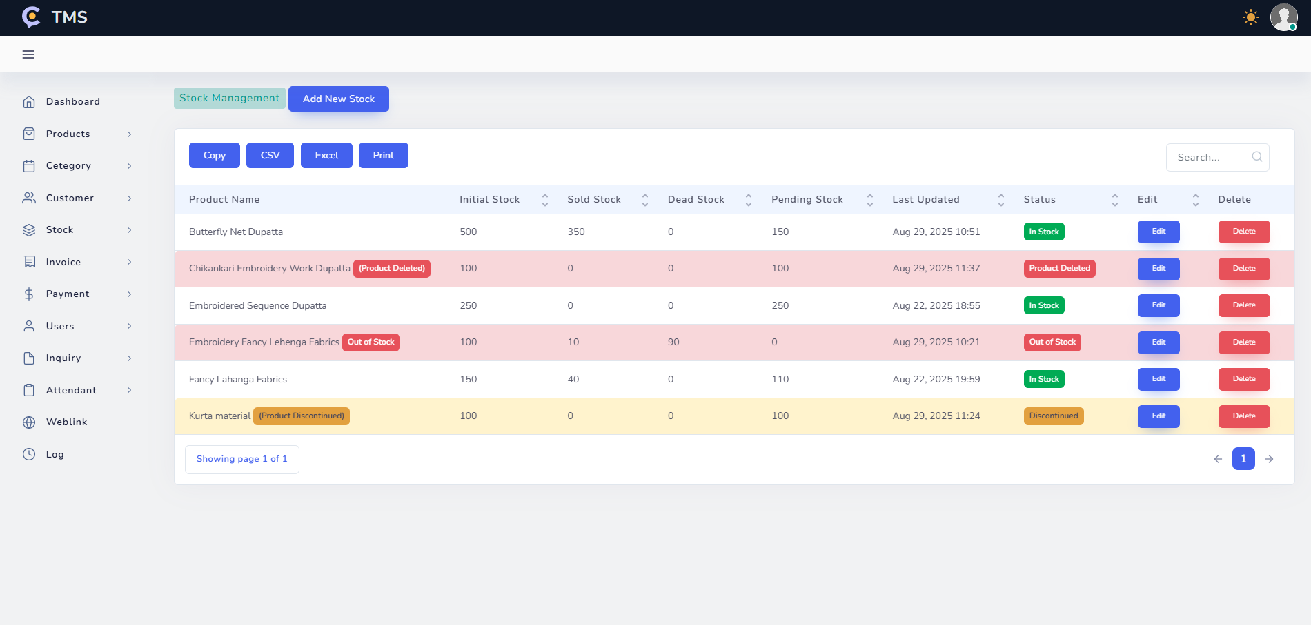

Slide 18
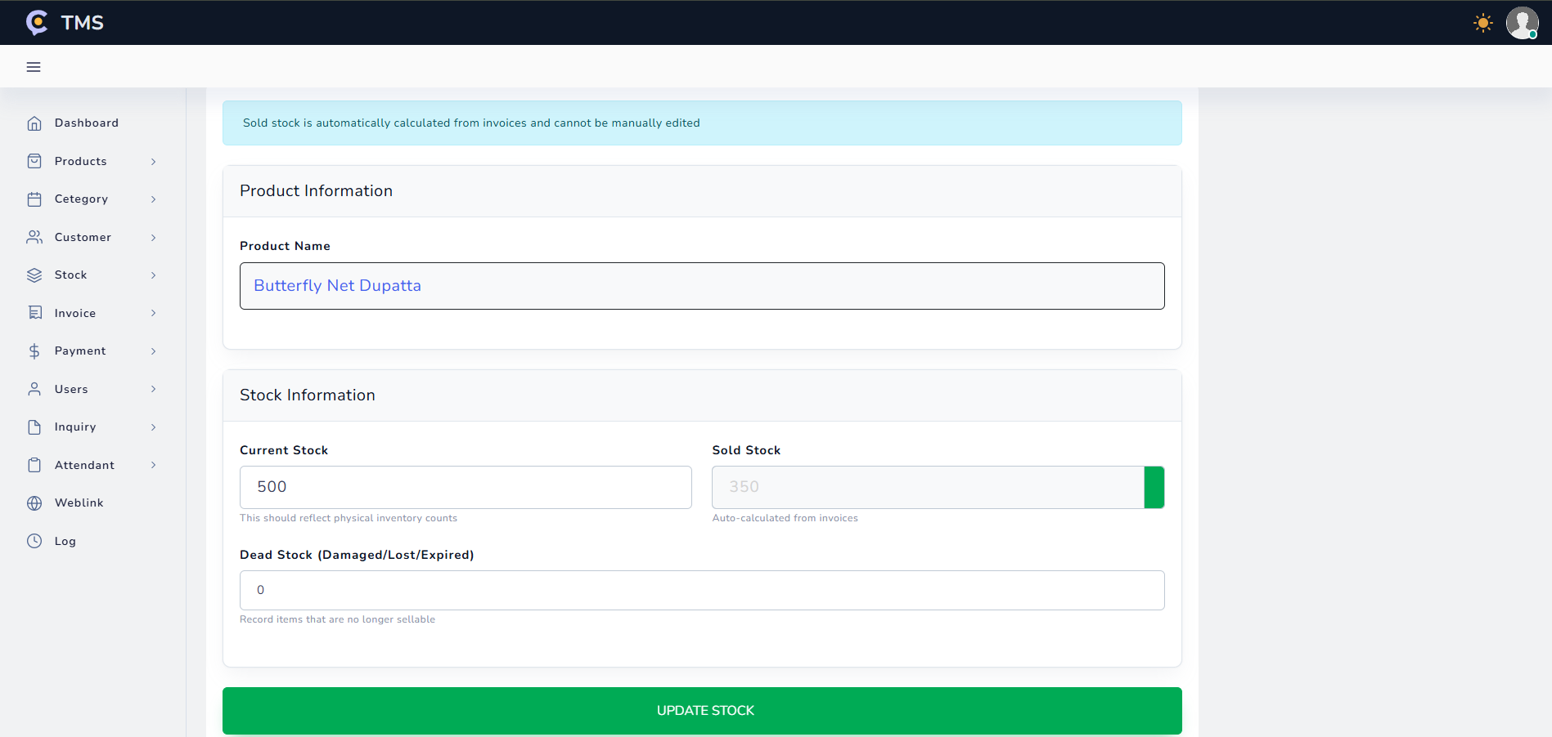

Slide 19
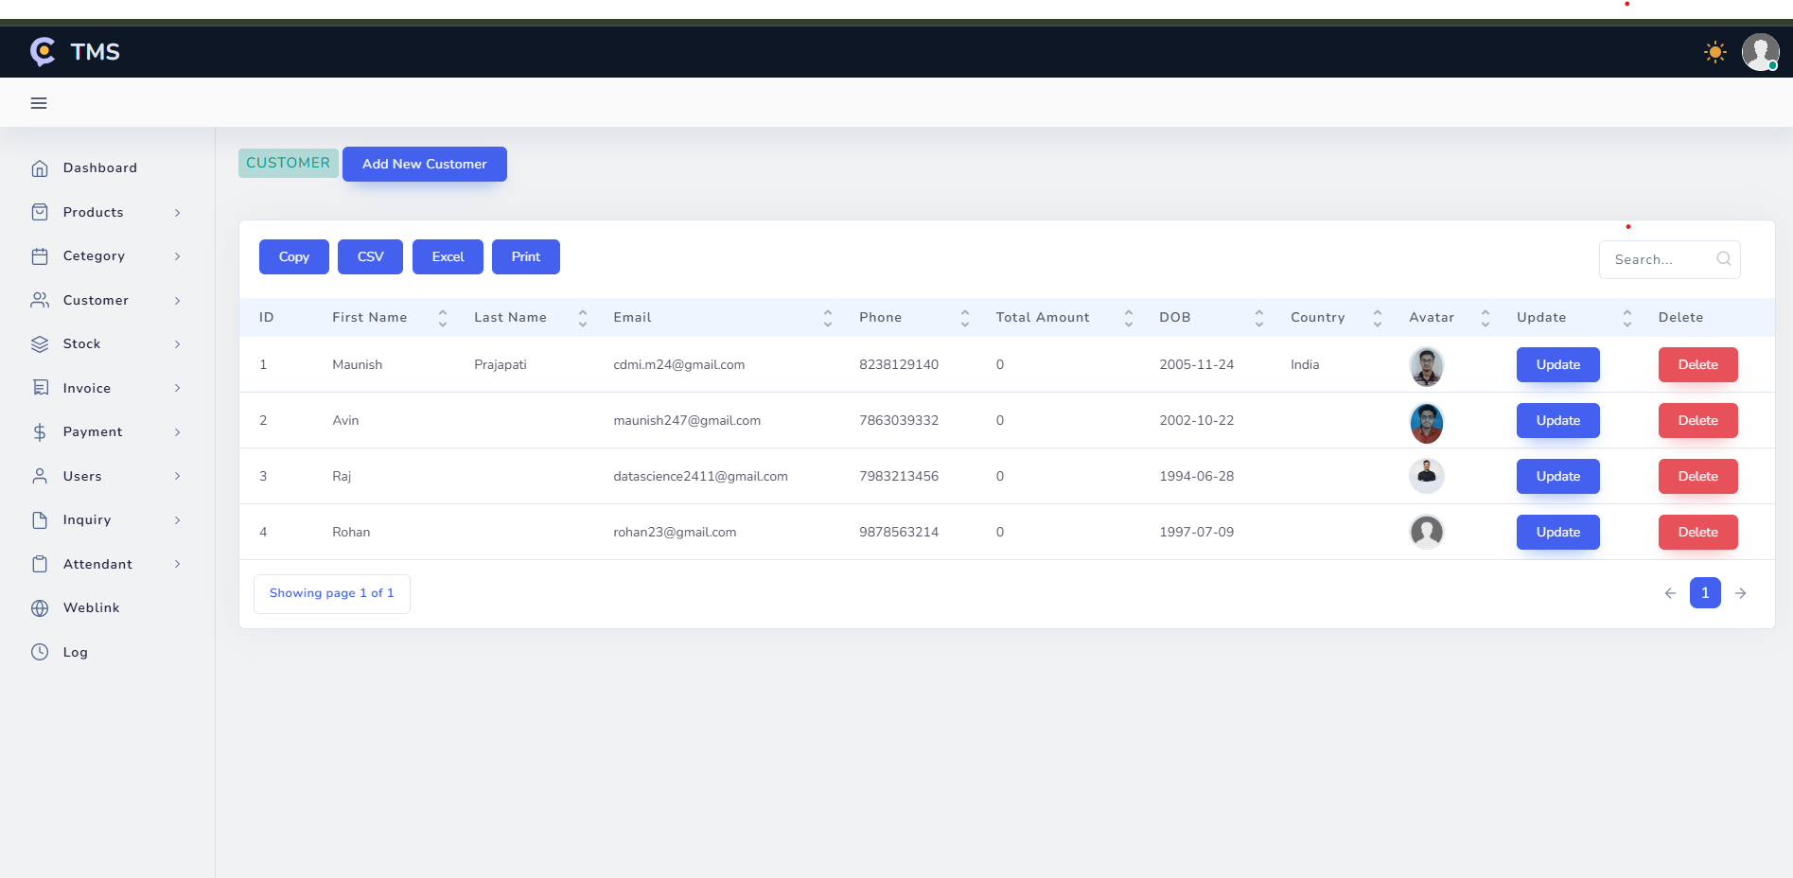

Slide 20
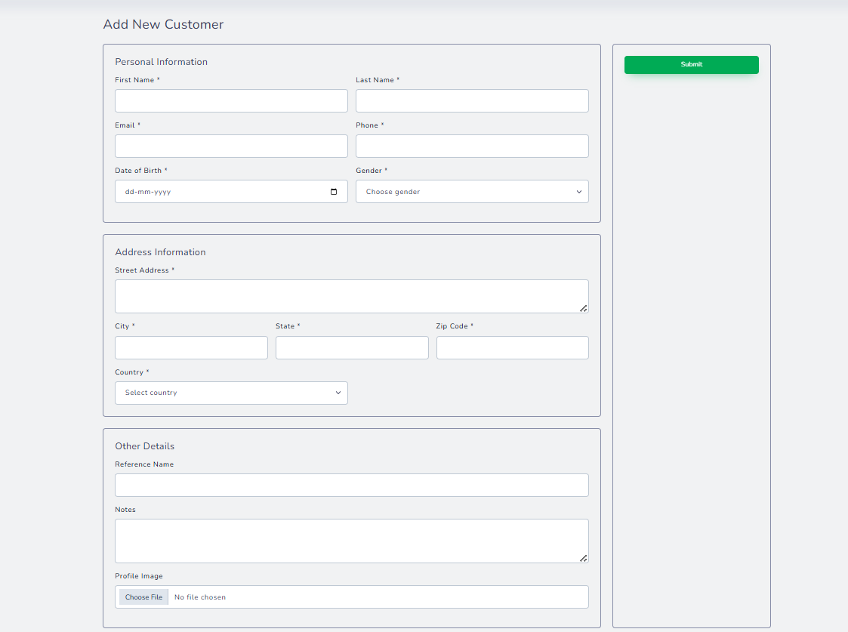

Slide 21
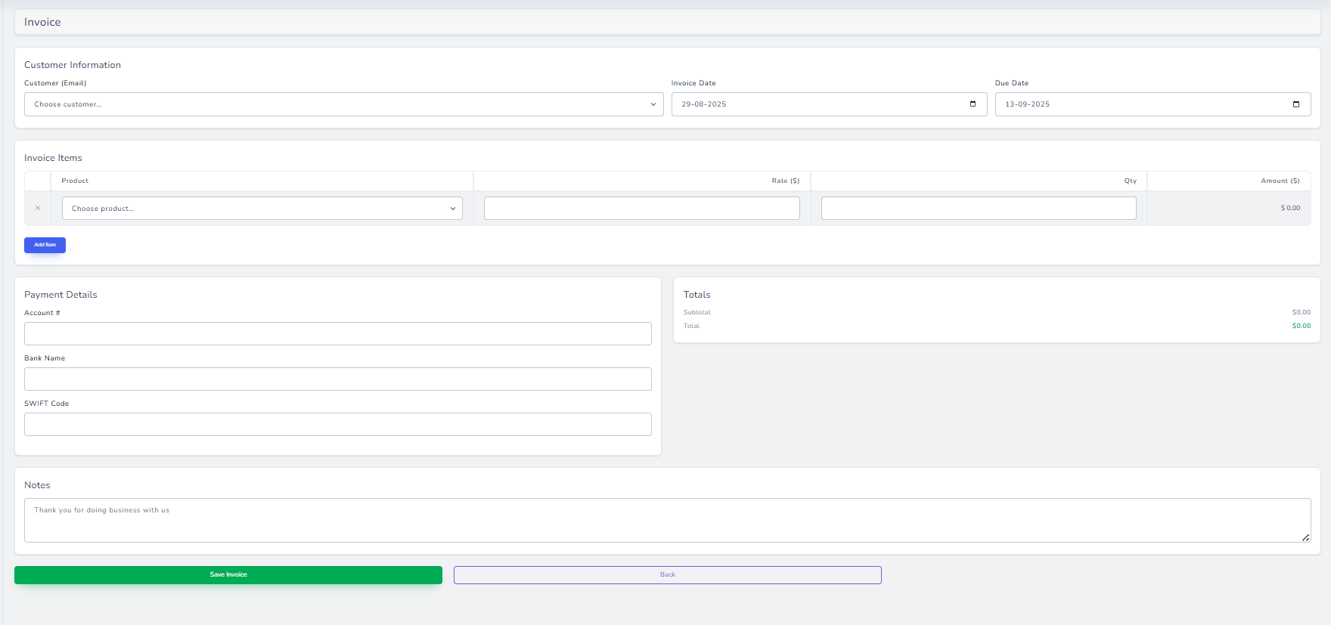

Slide 22
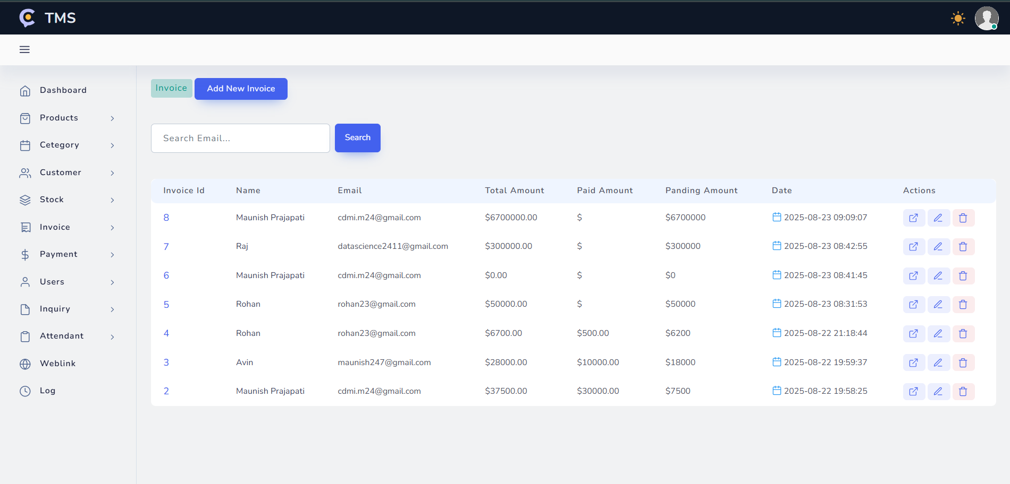

Slide 23
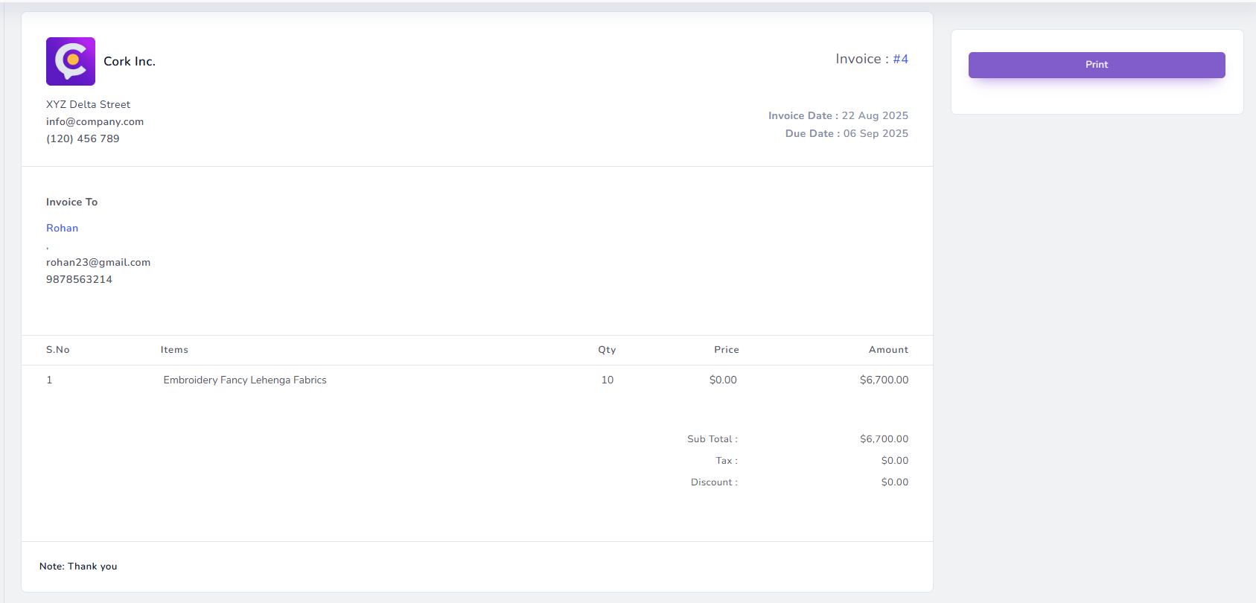

Slide 24
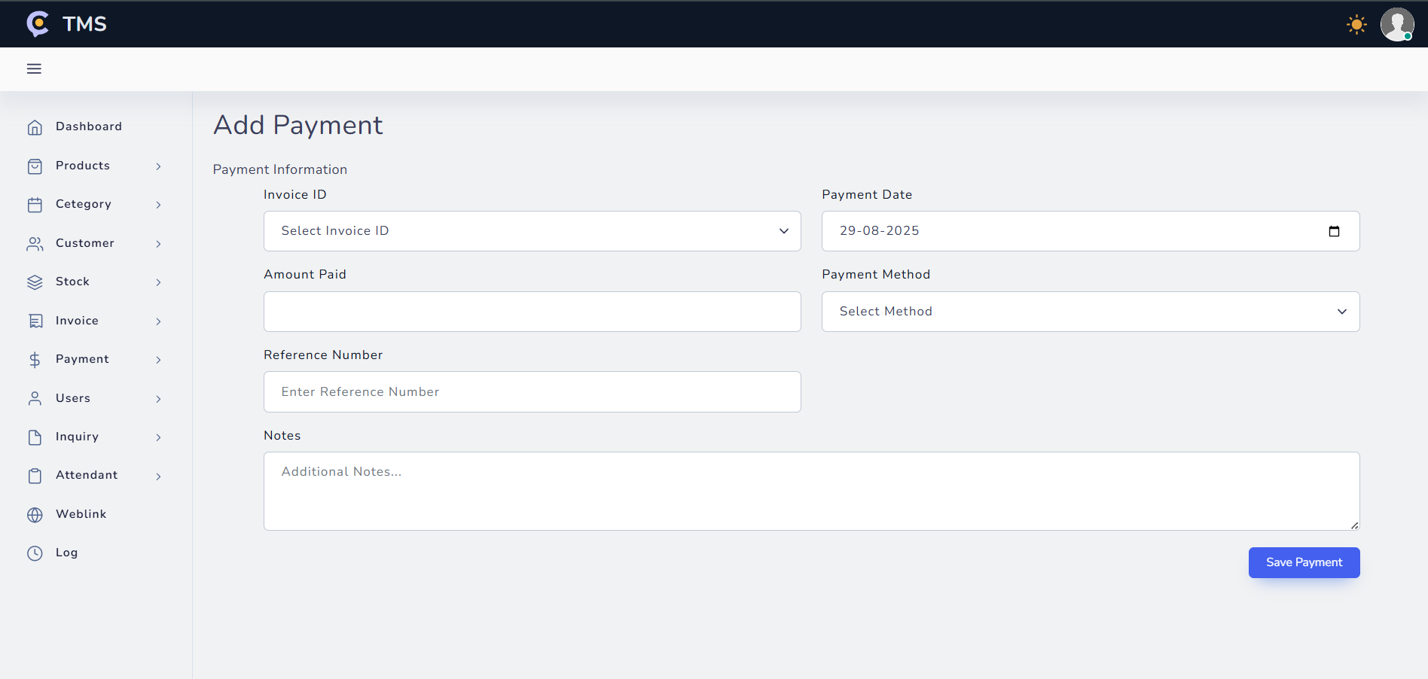

Slide 25
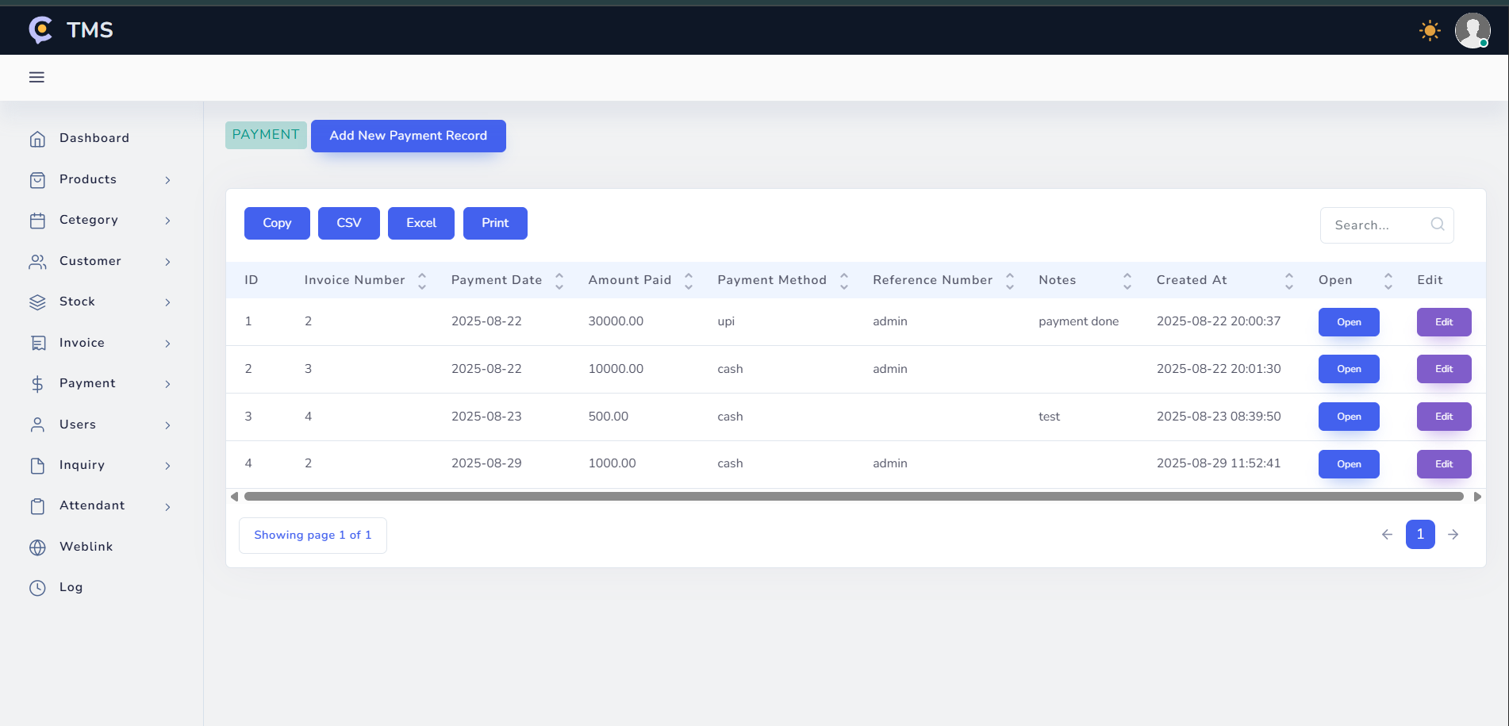

Slide 26
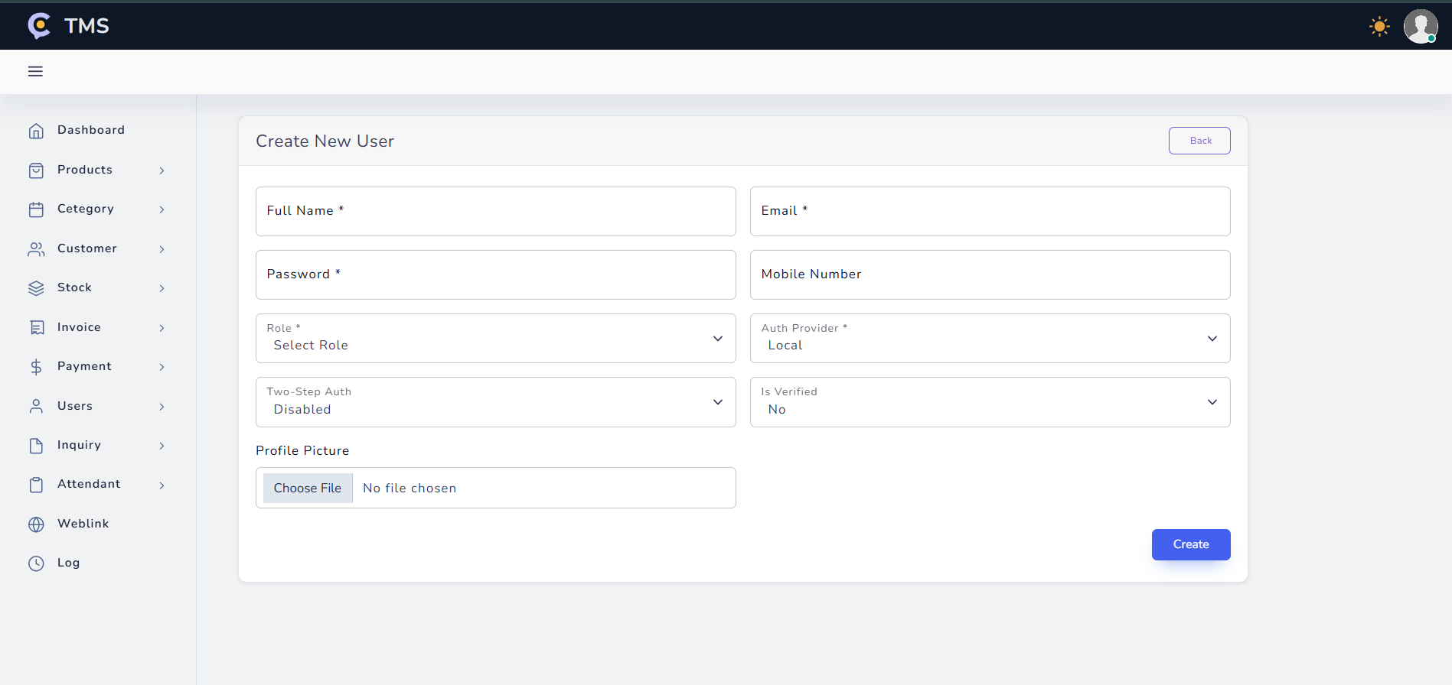

Slide 27
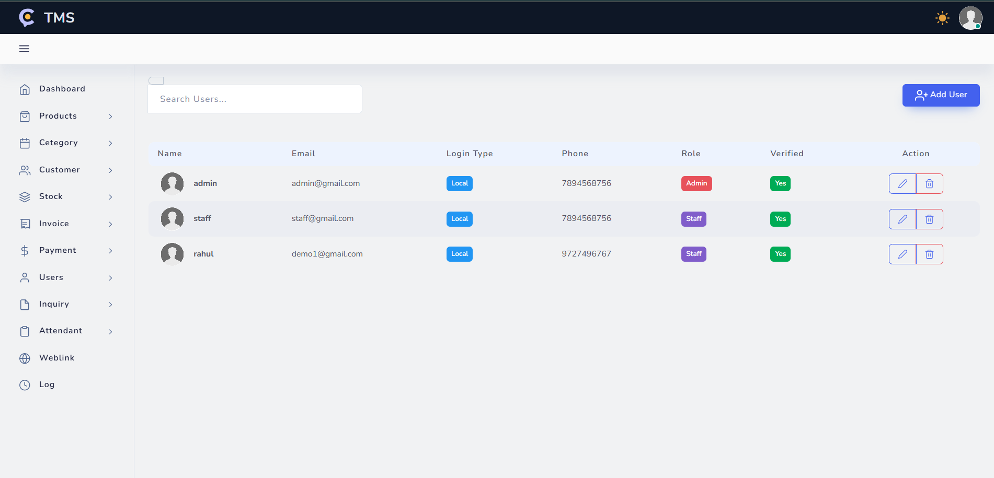

Slide 28
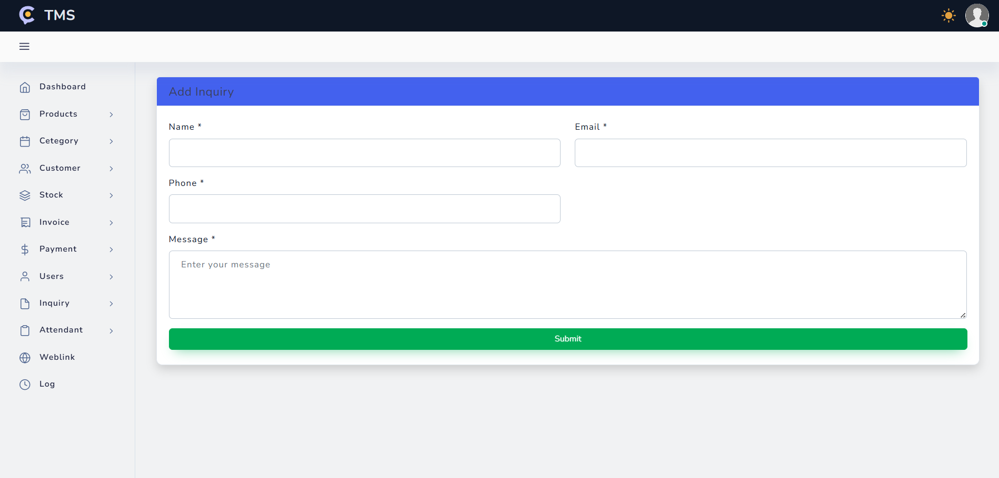

Slide 29
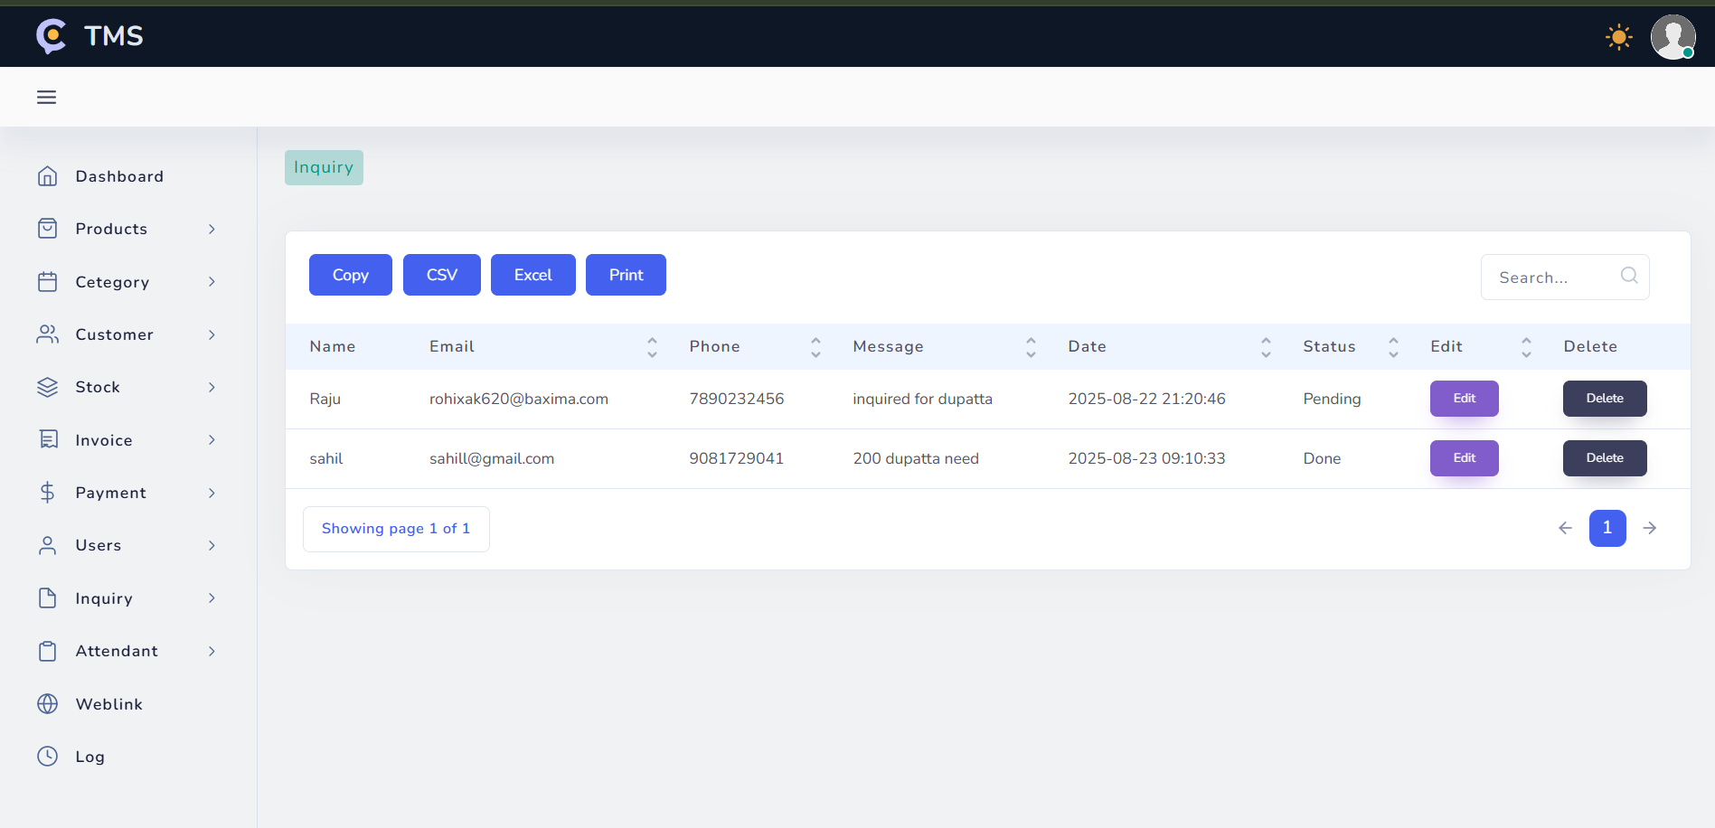

Slide 30
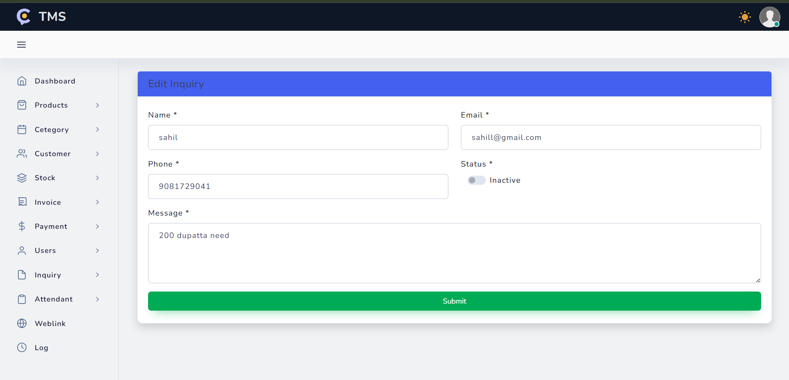

Slide 31
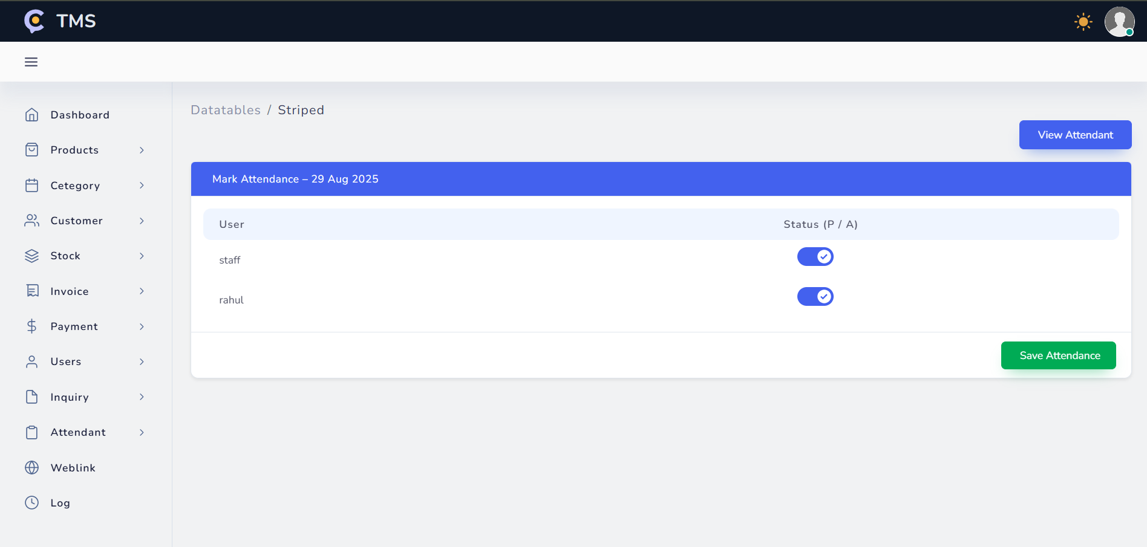

Slide 32
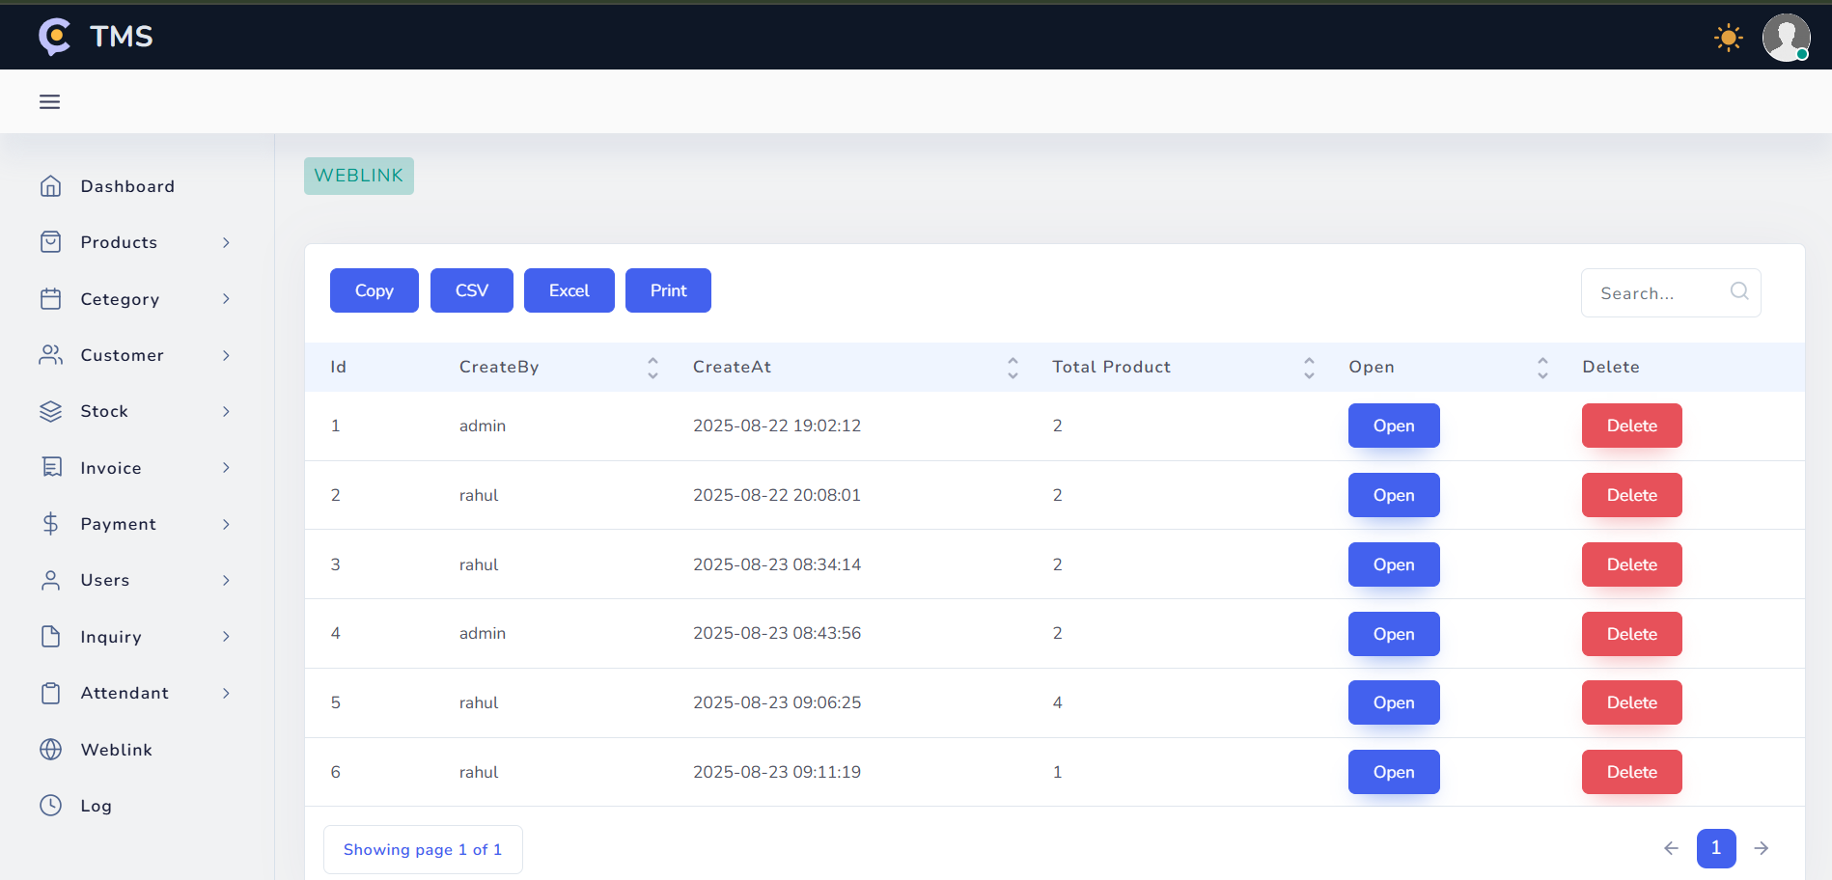

Slide 33
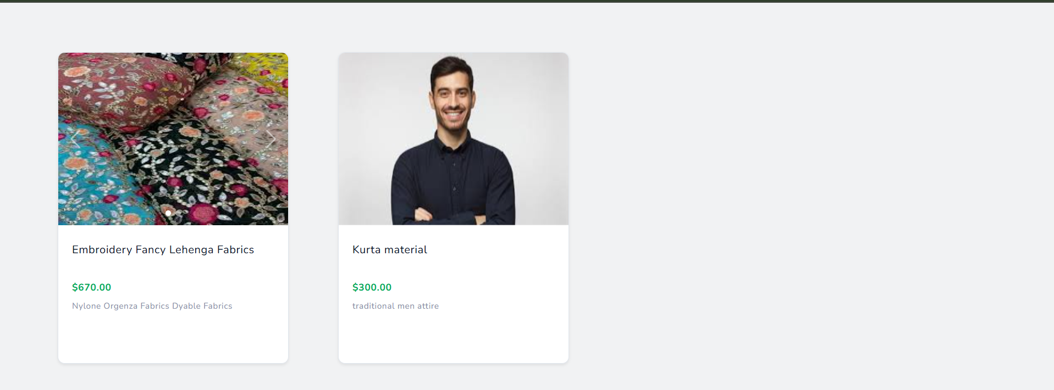

Slide 34
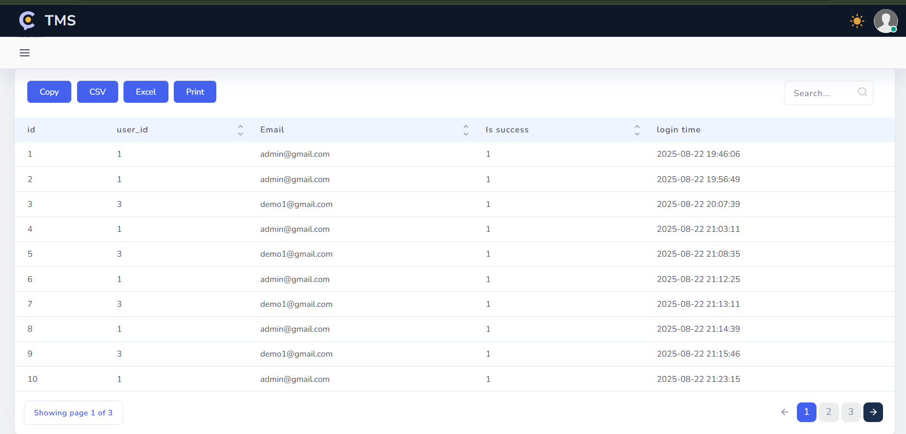

Slide 35





Future Enhancements & Conclusion
Taking the Textile Management System to the next level
TMS Benefits Future Plans
Automated inventory and sales tracking with error reduction
Mobile application for on-the-go inventory management
Centralized management of all textile business operations
REST API development for third-party integrations
Advanced analytics and business intelligence features
Real-time performance monitoring and analytics
Secure role-based access and data management
E-commerce integration for online sales channels
Q&A
Thank you for your attention!

